Slide 1
CS 4032 – Web Programming
Dr. Hassan Sartaj

Slide 2
About Me
Assistant Professor at NUCES-FAST
Ph.D. (Software Engineering)
More than 7.5 years of experience
Projects: Ground Control Station (GCS), Ardupilot for Formation Flight, Traffic Monitoring System, Home Automation System, etc.
SnT Luxembourg, Pakistan Air Force, AvDi PAC Kamra
Visiting Lecturer
Web Programming – Spring 2021
Object Oriented Programming – Fall 2021
Graduate Student Member & Chapter Treasurer of IEEE Computer Society
Winner of Upsilon Pi Epsilon (UPE) award in 2019
IEEE Computer Society
MS(SE) with Gold Medal

Slide 3
Contact Details
Email: hassan.sartaj@nu.edu.pk
Office:
Room# A-304E
Contact Hours
Tuesday: 11:30 to 01:00
Wednesday: 10:00 to 04:00
Thursday: 01:00 to 02:00

Slide 4
Course Objectives
Understanding of modern web application development technologies
Develop and design Web interfaces using latest UI frameworks
Understand the best web development practices being followed in the industry
Training on industry-oriented web frameworks
Utilize the incredible power of web technologies
Develop web based of MEAN, MERN, and Serverless Stack

Slide 5
Course is really different mini-courses
Frontend Technologies
HTML5, CSS3, JavaScript Angular, ReactJS
Backend Technologies
NodeJS, ExpressJS, MongoDB
Web Service Technologies
Amazon AWS
Google Cloud
Azure Services

Slide 6
Target Students
Want to pursue good career as a Full Stack Web Developer/Web Designer
Want to learn cutting-edge Web development technologies
Want to get hands-on practice on industry-oriented web frameworks
Feel Comfortable in coding (e.g., C++, Java, Python...)
Has built, or could build, a single-user application
Ready to take coding challenges

Slide 7
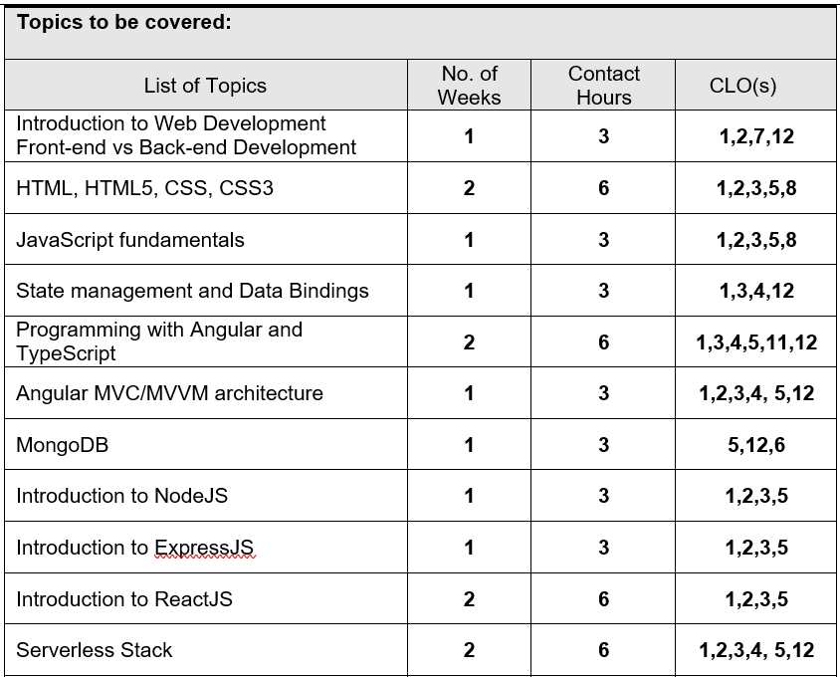
Contents and Organization

Slide 8
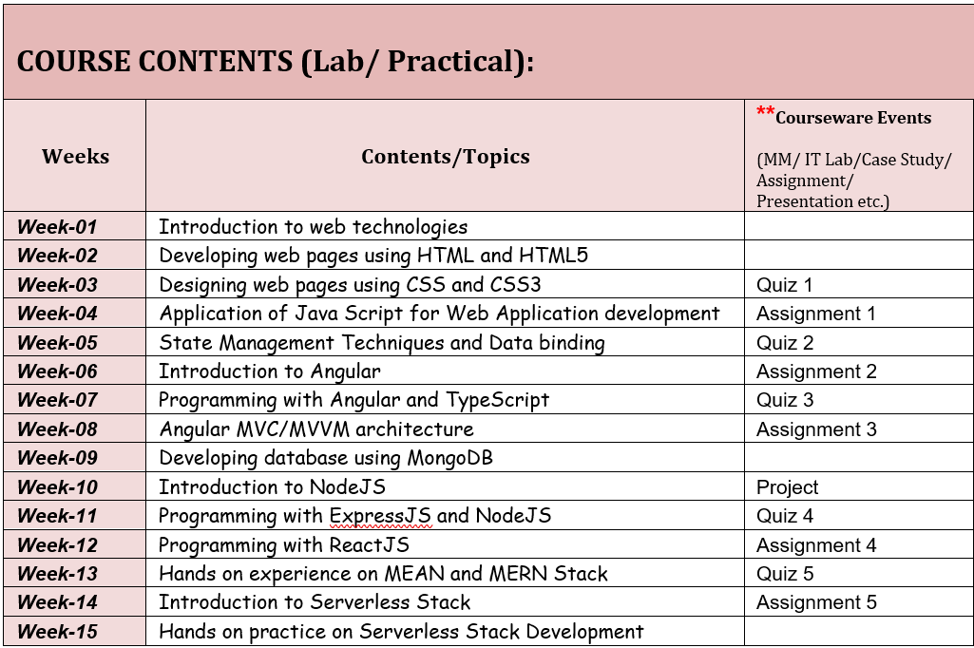
Contents and Organization

Slide 9
Tentative Marks Distribution
Assessment Item | Number | Weight (%)
Quizzes | >=5 | 5
Assignments | >=5 | 20
Midterm Exam | 1 | 20
Project | 1 | 15
Final Exam | 1 | 40
Grading policy: Absolute grading scheme

Slide 10
Class Policies and Guidelines
Attendance policy:
Will be taken at the start of the class. Students appearing late in the class after the attendance will be marked “Absent”
80% attendance is compulsory
Plagiarism policy:
Plagiarism in midterm/final exam may result in F grade in the course.
Plagiarism in an assignment items (assignments, quizzes & project) will result in zero marks in the whole assignments items category. If fore mentioned act is repeated more than once the instructor can refer a case to the Department Disciplinary Committee (the maximum punishment can be award of 'F' grade in that course.)

Slide 11
Class Policies and Guidelines
Course retake policy:
Midterm/final exam retake
The examination assessment and retake committee decide the exam retake/pretake cases.
Assignments/quizzes retake
There will be no retake of any assignment or quiz.

Slide 12
Class Policies and Guidelines
Assignments or project submission policy:
Use the following rules for your submissions
Combine all files in one zip file
Name the zip file as ROLLNO_NAME_SECTION.zip
Submit the zip file on Slate before the deadline
No submission on Google Classroom
Late submissions will not be accepted

Slide 13
Assignments and Projects
Where ~80% of your learning will take place
For learning, not evaluation -> low marks (~25%)
Posted to Google Classroom and Slate
All assignments will be individual and project will be in group (max. 2-3 students)
Program must work, compile errors / runtime errors lose all correctness points
Copying solution code or giving code to someone else is CHEATING -> F in the course

Slide 14
Class Policies and Guidelines
Don’ts
Use of cell phones
Discussion with fellows during class
Early leave
Frequent movements In-out of class
Do’s
Be interactive, ask questions
Participate in the lecture especially during hands-on practice
Be prepared for practice sessions

Slide 15
Textbooks and Reference Material
Web Application Architecture Principles, protocols and practices by Leon Shklar and Richard Rosen
The Missing Link: An Introduction to Web Development and Programming by Michael Mendez
Learning JavaScript, 3rd Edition by Todd Brown
Full Stack JavaScript Development With MEAN By Adam Bretz & Colin J. Ihrig
Full-Stack React Projects, Second Edition by Shama Hoque

Slide 16
Google Classroom
Invite link
https://classroom.google.com/c/NDU0OTIyMjUyNTEz?cjc=a2gzjzj
Class code
a2gzjzj
Lectures, reference material, announcements

Slide 17
Introduction to Web

Slide 18
Web Essentials
Client: web browsers, used to surf the Web
Server systems: used to supply information to these browsers
Computer networks: used to support the browser-server communication
Internet
Request “document A”
document A
Client
Server

Slide 19
The Internet: a inter-connected computer networks, linked by wires, cables, wireless connections, etc.
Web: a collection of interconnected documents and other resources.
The world wide web (WWW) is accessible via the Internet, as are many other services including email, file sharing, etc.
Internet v.s. Web

Slide 20
How does the Internet Work?
Through communication protocols
A communication protocol is a specification of how communication between two computers will be carried out
IP (Internet Protocol): defines the packets that carry blocks of data from one node to another
TCP (Transmission Control Protocol) and UDP (User Datagram Protocol): the protocols by which one host sends data to another.
Other application protocols: DNS (Domain Name Service), SMTP (Simple Mail Transfer Protocol), and FTP (File Transfer Protocol)

Slide 21
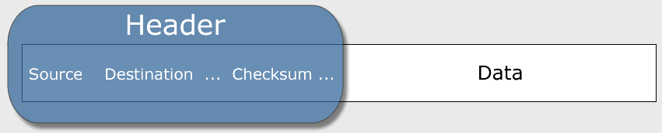
The Internet Protocol (IP)
A key element of IP is IP address, a 32-bit number
The Internet authorities assign ranges of numbers to different organizations
IP is responsible for moving packet of data from node to node
A packet contains information such as the data to be transferred, the source and destination IP addresses, etc.
Packets are sent through different local network through gateways
A checksum is created to ensure the correctness of the data; corrupted packets are discarded
IP-based communication is unreliable

Slide 22
The Transmission Control Protocol (TCP)
TCP is a higher-level protocol that extends IP to provide additional functionality
reliable communication
two-way (full duplex) communication
TCP adds support to detect errors or lost data and to trigger retransmission until the data is correctly and completely received
Connection
Acknowledgment

Slide 23
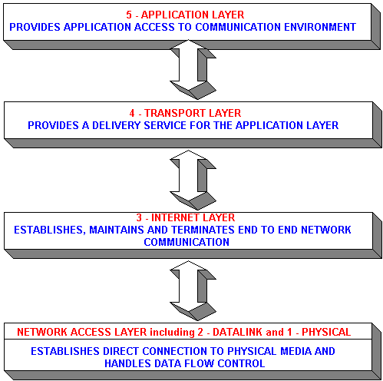
TCP/IP Protocol Suites
HTTP, FTP, Telnet, DNS, SMTP, etc.
TCP, UDP
IP (IPv4, IPv6)
23

Slide 24
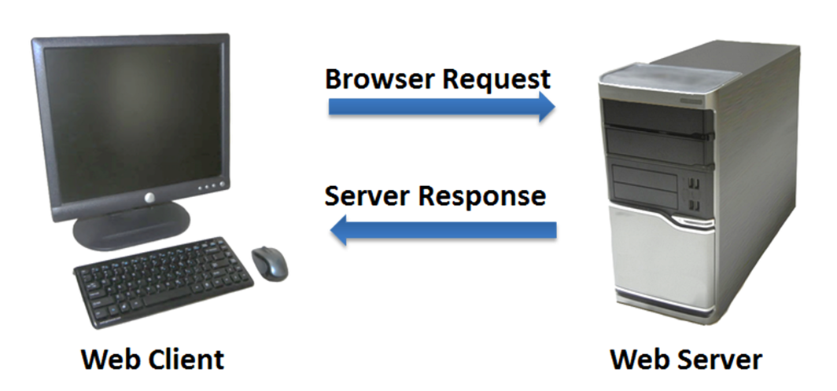
The World Wide Web (WWW)
WWW is a system of interlinked, hypertext documents that runs over the Internet
Two types of software:
Client: a system that wishes to access the information provided by servers must run client software (e.g., web browser)
Server: an internet-connected computer that wishes to provide information to others must run server software
Client and server applications communicate over the Internet by following a protocol built on top of TCP/IP – HyperText Transfer Protocol (HTTP)

Slide 25
Basics of the WWW
Hypertext: a format of information which allows one to move from one part of a document to another or from one document to another through hyperlinks
Uniform Resource Locator (URL): unique identifiers used to locate a particular resource on the network
Markup language: defines the structure and content of hypertext documents

Slide 26
Web Client: Browser
Makes HTTP requests on behalf of the user
Reformat the URL entered as a valid HTTP request
Use DNS to convert server’s host name to appropriate IP address
Establish a TCP connection using the IP address
Send HTTP request over the connection and wait for server’s response
Display the document contained in the response
If the document is not a plain-text document but instead is written in HTML, this involves rendering the document (positioning text, graphics, creating table borders, using appropriate fonts, etc.)

Slide 27
Web Servers
Main functionalities:
Server waits for connect requests
When a connection request is received, the server creates a new process to handle this connection
The new process establishes the TCP connection and waits for HTTP requests
The new process invokes software that maps the requested URL to a resource on the server
If the resource is a file, creates an HTTP response that contains the file in the body of the response message
If the resource is a program, runs the program, and returns the output

Slide 28
Domain Name
Locates an organization or other entity on the Internet
Domain Name System (DNS)
Divides the Internet into logical groups and understandable names
Associates unique computer IP Addresses with the text-based domain names you type into a web browser
Browser: http://google.com
IP Address: 173.194.116.72

Slide 29
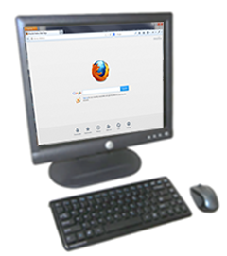
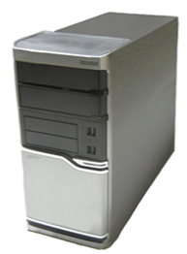
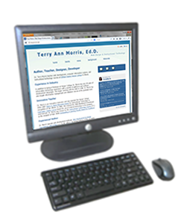
Domain Name System
The Domain Name System (DNS) associates Domain Names with IP addresses.
Domain Name
DNS
IP Address
Web Browser
Web Server
Use TCP/IP to send HTTP Request
Use TCP/IP to send HTTP Responses with web page files & images
Web Browser displays web page

Slide 30
Top-Level Domain (TLD) Name
A top-level domain (TLD) identifies the right-most part of the domain name.
Examples of generic TLDs: .com, .org, .net, .mil, .gov, .edu, .int, .aero, .asia, .cat, .jobs, .name, .biz, .mobi, .museum, .info, .coop, .post, .pro, .tel, .travel

Slide 31
County Code TLDs
Two character codes originally intended to indicate the geographical location (country) of the web site.
In practice, it is fairly easy to obtain a domain name with a country code TLD that is not local to the registrant.
Examples:
.tv, .ws, .au, .jp, .uk
See http://www.iana.org/cctld/cctld-whois.htm

Slide 32
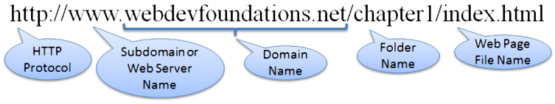
Uniform Resource Identifier
URI – Uniform Resource Identifier
identifies a resource on the Internet
URL – Uniform Resource Locator
a type of URI which represents the network location of a resource such as a web page, a graphic file, or an MP3 file.

Slide 33
Static Web: HTML/XHTML, CSS
HTML stands for HyperText Markup Language
It is a text file containing small markup tags that tell the Web browser how to display the page
XHTML stands for eXtensible HyperText Markup Language
It is identical to HTML 4.01
It is a stricter and cleaner version of HTML
E.g., <!DOCTYPE>, <html>, <head>, and <body> are mandatory
CSS stands for Cascading Style Sheets
It defines how to display HTML elements

Slide 34
Static web limitations
What is the drawback to simple document model?
Static
Assume that documents are created before they are requested
What are examples of information that might be part of web documents that may not be known before they are requested?

Slide 35
Client-Side Programming
Scripting language: a lightweight programming language
Browser scripting: JavaScript
Designed to add interactivity to HTML pages
Usually embedded into HTML pages
What can a JavaScript Do?
Put dynamic text into an HTML page
React to events
Read and write HTML elements
Validate data before it is submitted to a server
Create cookies
…

Slide 36
Server-Side Programming
The requests cause the response to be generated
Server scripting:
ASP.Net MVC: Microsoft product, uses .Net framework (*.asp)
CGI/Perl: Common Gate Way Interface (*.pl, *.cgi)
PHP: Open source, strong database support (*.php)
Java via JavaServer Pages (*.jsp)
…

Slide 37
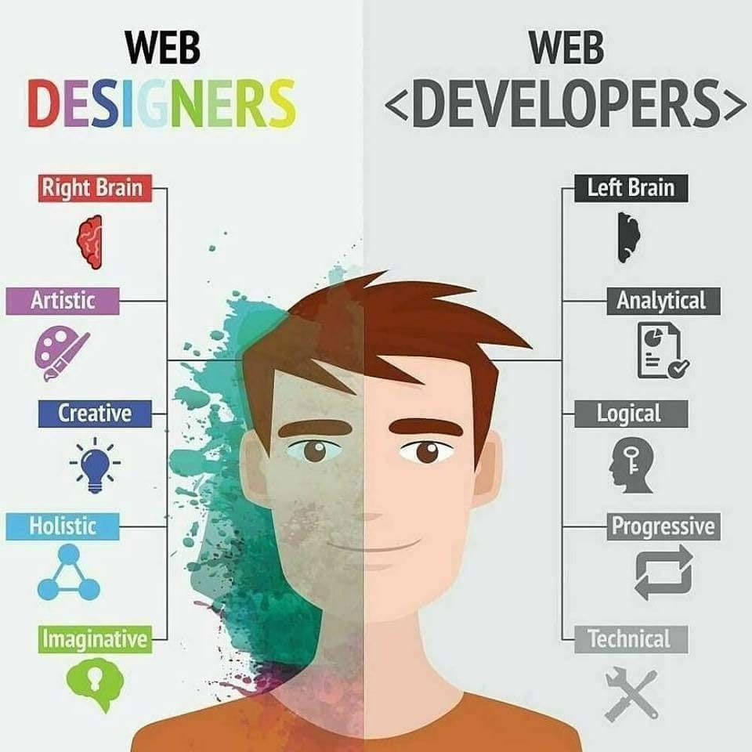
Web Development vs Designing

Slide 38


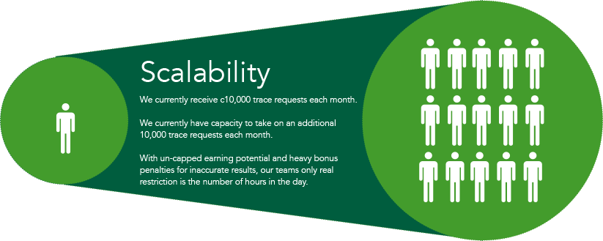
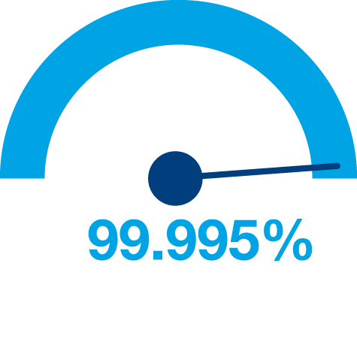

Principles of Web Design
Availability
Performance
Reliability
Scalability
Manageability
Cost
Notes:
Availability: The uptime of a website is absolutely critical to the reputation and functionality of many companies. For some of the larger online retail sites, being unavailable for even minutes can result in thousands or millions of dollars in lost revenue, so designing their systems to be constantly available and resilient to failure is both a fundamental business and a technology requirement. High availability in distributed systems requires the careful consideration of redundancy for key components, rapid recovery in the event of partial system failures, and graceful degradation when problems occur.
Performance: Website performance has become an important consideration for most sites. The speed of a website affects usage and user satisfaction, as well as search engine rankings, a factor that directly correlates to revenue and retention. As a result, creating a system that is optimized for fast responses and low latency is key.
Reliability: A system needs to be reliable, such that a request for data will consistently return the same data. In the event the data changes or is updated, then that same request should return the new data. Users need to know that if something is written to the system, or stored, it will persist and can be relied on to be in place for future retrieval.
Scalability: When it comes to any large distributed system, size is just one aspect of scale that needs to be considered. Just as important is the effort required to increase capacity to handle greater amounts of load, commonly referred to as the scalability of the system. Scalability can refer to many different parameters of the system: how much additional traffic can it handle, how easy is it to add more storage capacity, or even how many more transactions can be processed.
Manageability: Designing a system that is easy to operate is another important consideration. The manageability of the system equates to the scalability of operations: maintenance and updates. Things to consider for manageability are the ease of diagnosing and understanding problems when they occur, ease of making updates or modifications, and how simple the system is to operate. (I.e., does it routinely operate without failure or exceptions?)
Cost: Cost is an important factor. This obviously can include hardware and software costs, but it is also important to consider other facets needed to deploy and maintain the system. The amount of developer time the system takes to build, the amount of operational effort required to run the system, and even the amount of training required should all be considered. Cost is the total cost of ownership.

Slide 39
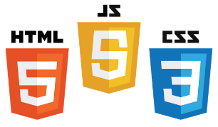

Web Applications
.
UI (Front End (DOM, Framework))
Request Layer (Web API)
Back End (Database, Logic)
Server
Client
API
Front End
Database
Browser
Internet
Logic
JSON
Media Cache

Slide 40
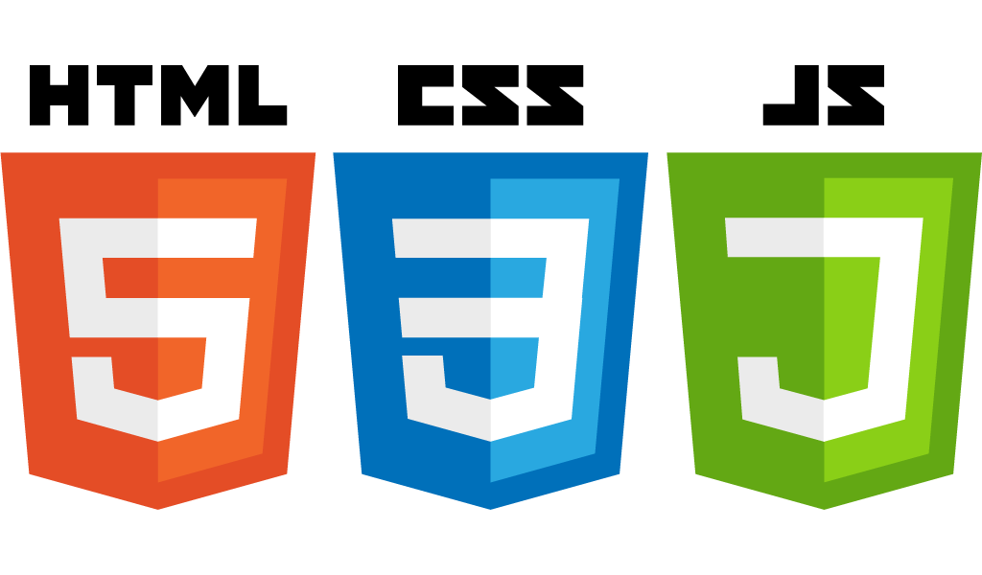
Frontend development

Slide 41
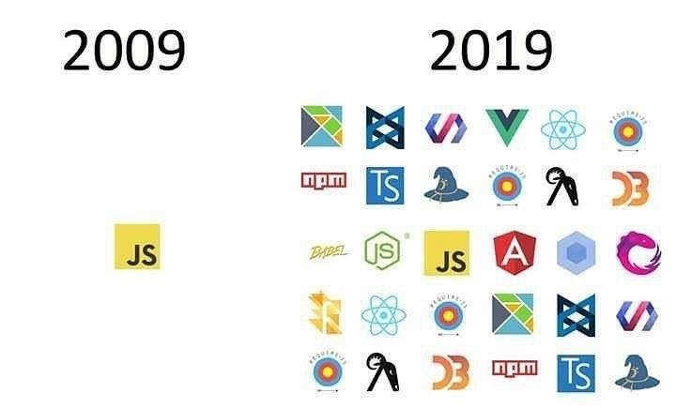
Front End Languages
HTML/CSS
JavaScript
Java (applets)
What is the most popular?
Answer: JavaScript/HTML/CSS is the only real option for front-end native languages and is basically the standard. But there are many variations on JavaScript that are used.
Today
Notes:
Javascript adoption with ES6, ‘don’t forget about babel’
Node.js:
Swift 2: Apples vision for modern web programming
Go: growing in popularity with startups
TypeScript: Beauty of statically type Javascript (PS: Microsoft Technology)

Slide 42

DOM (Document Object Model)
Document Object Model makes every addressable item in a web application an Object that can be manipulated for color, transparency, position, sound and behaviors.
Every HTML Tag is a DOM object

Slide 43
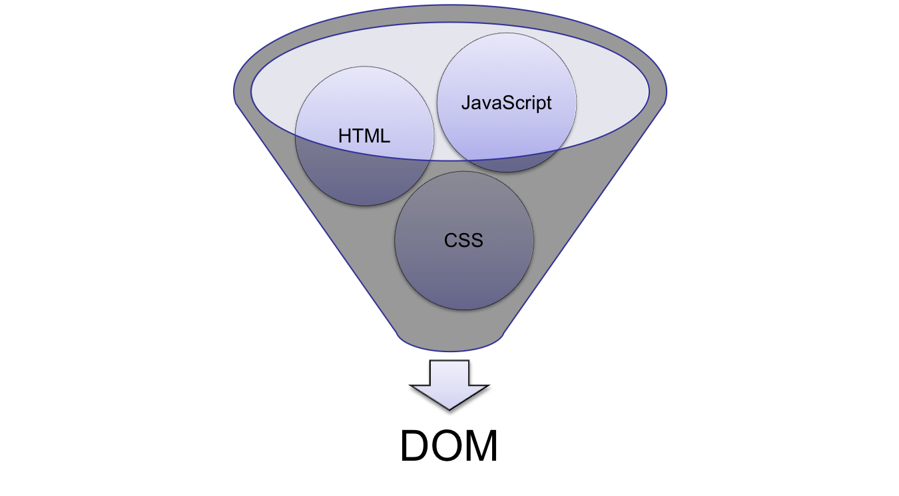
DOM (Document Object Model)
Notes:
HTML: Creates the DOM
CSS: Decorates the DOM
JavaScript: Modifies the DOM Dynamically
Back End Language: (PHP, Python, Ruby, F#): Generates the DOM on the fly

Slide 44
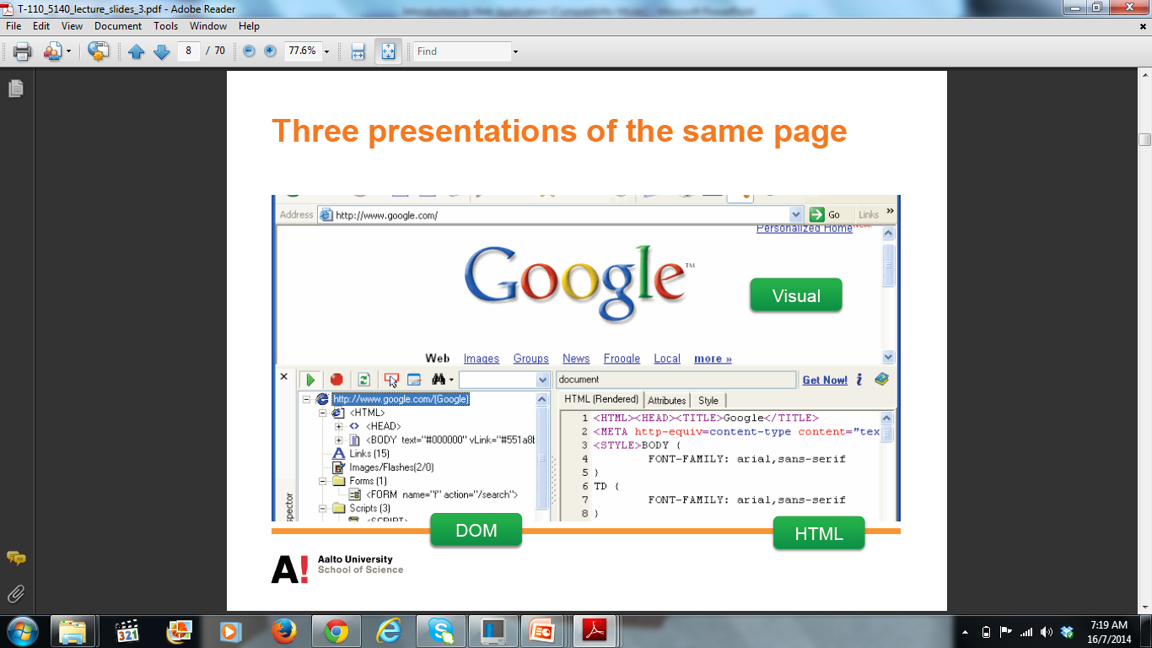
Three representations of same page

Slide 45
Software Architectural Pattern and Framework
Software Architectural Pattern
An architectural pattern expresses a fundamental structural organization schema for software systems
It provides a set of predefined subsystems, their responsibilities, and includes rules and guidelines for organizing the relationships between them
Software Framework
A platform for developing software applications
It provides a foundation on which software developers can build programs for a specific platform
May include predefined classes and functions or APIs that can be used to process input, manage hardware/software components, etc.

Slide 46
MVC (Model View Controller)
Software architectural design pattern
Designed in 1970
Originally developed for desktop applications
Most frequently used for web applications
Separates application functionality
Promotes modular programming

Slide 47

MVC Overview
Controller
- Handles request flow
- Do not handle data logic
1. Request
4. Response
2. Get data
3. Get view
Model
- Handles data logic
- Interacts with database
View
- Handles data view
- Dynamically render

Slide 48
Web Frameworks That Use MVC
Spring (Java)
ASP.NET MVC (C#)
Ruby on Rails (Ruby)
Laravel (PHP)
Django (Python)
Flask(Python)
AngularJS
React (JS)
Ember (JS)
Express (JS)
Vue (JS)
Polymer (JS)

Slide 49
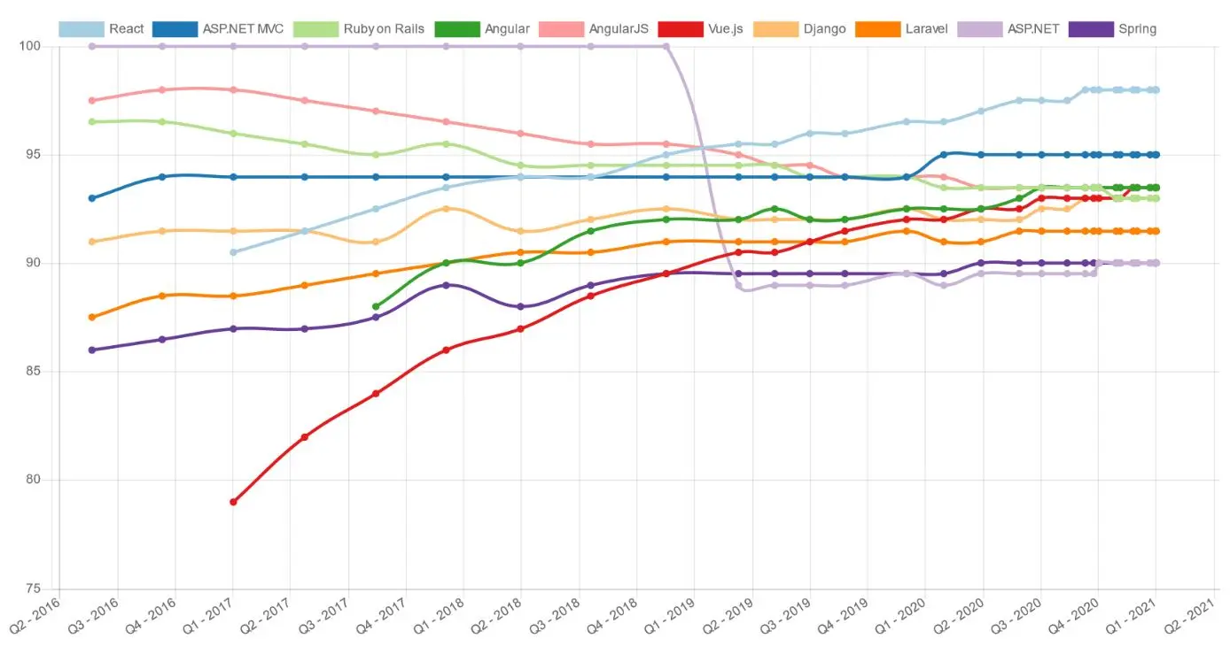
Popular frameworks
http://hotframeworks.com

Slide 50
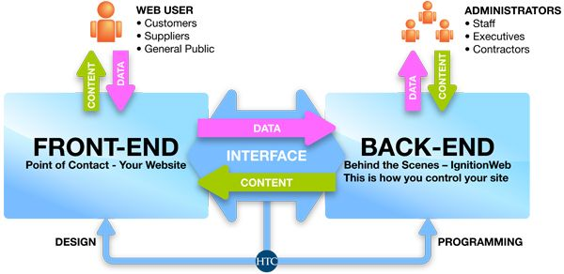
BACKEND development

Slide 51
What is a Backend?
All of the awesome that runs your application.
Web API
Connection layer between the frontend and backend
Connected through API calls (POST, GET, PUT, etc. )
Transmit Content from the Backend to the Frontend commonly in JSON Blobs
Service Architecture that drives everything (Where all the logic is)

Slide 52
Web APIs
Application Programming Interface (API)
Serves as an interface between different software programs and facilitates their interaction
A particular set of rules and specifications that a software program can follow to access and make use of the services and resources provided by another particular software program
Web API
The intermediate layer between front end and back-end systems
A “must have” if your APIs will be consumed by third-party services
Typically a defined set of HTTP request messages expressed in SOAP or REST along with a definition of the structure of response messages, typically expressed in JSON or XML.

Slide 53
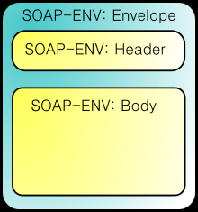
SOAP
Simple Object Access Protocol (SOAP)
SOAP Introduction:
http://msdn.microsoft.com/en-us/library/ms995800.aspx
A SOAP message is an ordinary XML document containing the following elements:
An Envelope element that identifies the XML document as a SOAP message
A Header element that contains header information
contains application-specific information about the SOAP message
optional
must be the first child element of the Envelope element
A Body element that contains call and response information
A Fault element containing errors and status information

Slide 54


REST
Representational State Transfer (REST)
Use HTTP method to invoke remote services (not XML)
The response of remote service can be in XML/JSON or any textual format
Benefits:
Easy to develop
Easy to debug (with standard browser)
Leverage existing web application infrastructure

Slide 55


Server Responses
Really Simple Syndication (RSS, Atom)
XML-based standard
Designed for news-oriented websites to “Push” content to readers
Excellent to monitor new content from websites
XML or JavaScript Object Notation (JSON)
Lightweight data-interchange format
Human readable and writable and also machine friendly
Wide support from most languages (Java, C, C#, PHP, Ruby, Python…)
Json: 48 bytes
XML: 83 bytes

Slide 56
Thank you!

